Slide 1
Chapter 13 : Education
Introduction
Problem
Snap Shot Fact Table & acucummulating
Factless Fact Table & Bus matrix
Despite being red, Mars is a cold place full of iron oxide dust
Explore Kimball implementation in Education Sector
Jupiter is a gas giant and the biggest planet in the Solar System

Slide 2
Introduction
In this presentation we are going to discuss the 13th chapter of the book “ The Data Warehouse Toolkit Third Edition ” by Ralph Kimball & Margy Ross.
In this chapter, an accumulating snapshot is used to monitor prospective student applicants as they progress through admissions Milestones
Before we delve into the specifics, let's briefly revisit the concept of snapshot fact table, accumulating snapshot fact table and factless fact.

Slide 3
Snapshot Fact table
snapshot fact table specifically stores aggregated data at a specific point in time, providing a snapshot view of a particular business process or metric. This type of fact table is useful for analyzing historical trends and changes over time.

Slide 4
Accumulating Snapshot Fact table
a type of fact table in a data warehouse that tracks the changes in a process over time by capturing key milestones and events. Unlike a regular snapshot fact table that only provides a snapshot at a specific point in time, an accumulating snapshot fact table accumulates data over a period to show the evolution of a process.

Slide 5
Factless Fact Table
A factless fact table is a table that contains only foreign keys to dimensions, but no numeric facts. It is used to capture events or situations that have no measurable outcome, but are important for analysis.

Slide 6
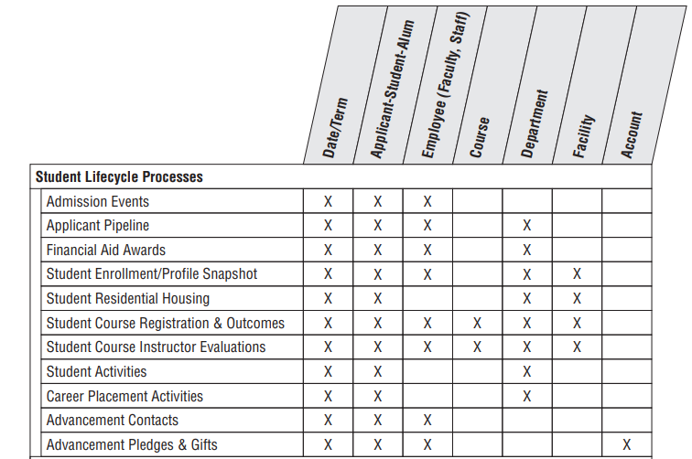
Focus
Figure : Bus matrix pour l'établissement d'enseignement.

Slide 7
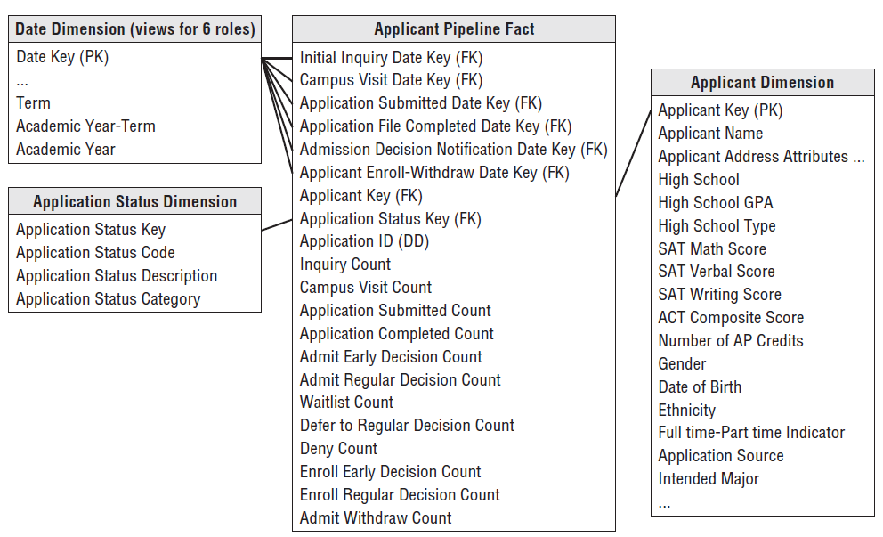
Applicant Pipline
Figure : Student applicant pipeline as an accumulating snapshot.

Slide 8
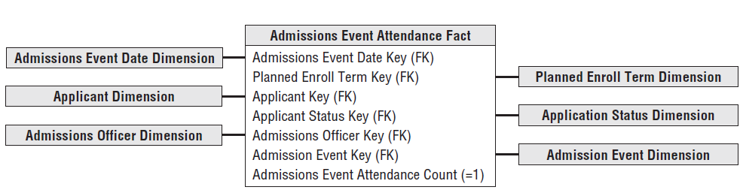
Admissions Events
Figure : Admission event attendance as a factless fact table.

Slide 9
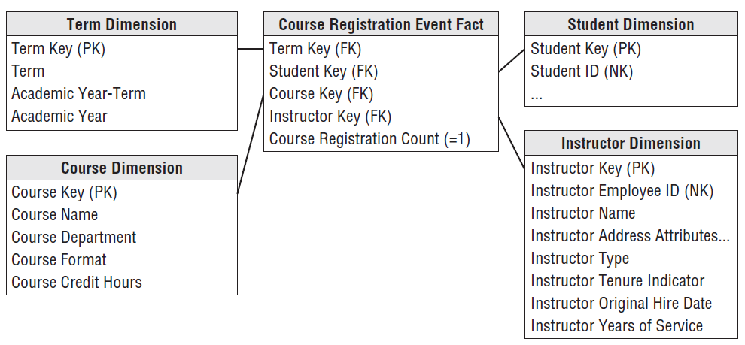
Course Registrations
Figure : Course registration events as a factless fact table.

Slide 10
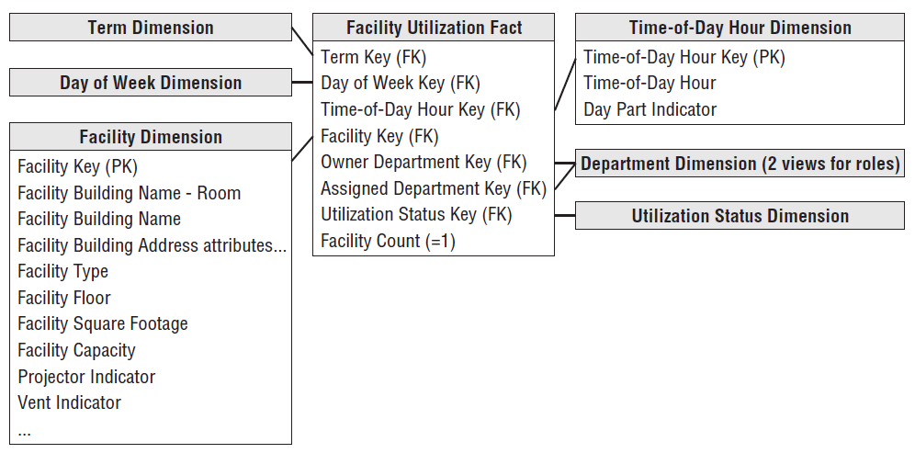
Facility Utilization
Figure : Facilities utilization as a coverage factless fact table.

Slide 11
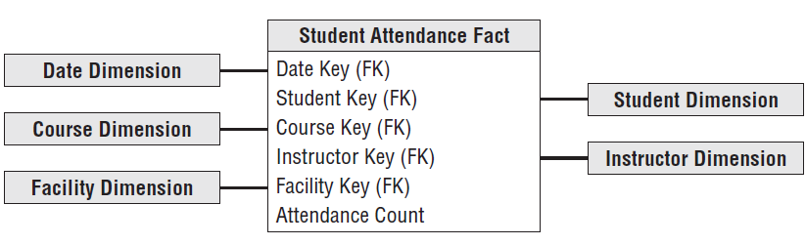
Students Attendance
Figure : Student attendance fact table fact table.

